Slide 1
Medical Segmentation Decathlon
Abhinav Jindal (2016csb1026)
Mattela Nithish (2016csb1042)

Slide 2
Project Overview
Problem from Grand challenges 2019
Generalized Medical Segmentation for Several Tasks
10 different tasks’ dataset available
Objectives:
Task specific parameters must not be human defined
Predict on these 10 tasks
Predict on future unseen tasks

Slide 3
Task Name | Modality | Dimensions | No of Images
Brain | Multimodal multisite MRI data (FLAIR, T1w, T1gd,T2w) | (240, 240, 155, 4) | 750 (484 Training + 266 Testing)
Liver | Portal venous phase CT | (512, 512, 247) | 201 (131 Training + 70 Testing)
Prostate | Multimodal MR (T2, ADC) | (320, 320, 20, 2) | 48 (32 Training + 16 Testing)
Hippocampus | Mono-modal MRI | (34, 53, 37) | 394 (263 Training + 131 Testing)
Spleen | CT | (512, 512, 164) | 61 (41 Training + 20 Testing)
Heart | Mono-modal MRI | (320, 320, 120) | 30 (20 Training + 10 Testing)
Lung | CT | (512, 512, 450) | 96 (64 Training + 32 Testing)
Pancreas | Portal venous phase CT | (512, 512, 82) | 420 (282 Training +139 Testing)
Colon | CT | (512, 512, 127) | 190 (126 Training + 64 Testing)
Hepatic Vessel | CT | (512, 512, 55) | 443 (303 Training + 140 Testing)

Slide 4
Labels Info
Task | Number of labels | Description
Brain | 4 | Background, Edema, Non enhancing tumor, Enhancing tumor
Heart | 2 | Background, left atrium
Liver | 3 | Background, Liver, Cancer
Hippocampus | 3 | Background, anterior, posterior
Prostate | 3 | Background, TZ,PZ
Lung | 2 | Background, Cancer
Pancreas | 3 | Background, Pancreas, Cancer
Hepatic Vessel | 3 | Background, Vessel, Tumor
Spleen | 2 | Background, Spleen
Colon | 2 | Background, Colon cancer primaries

Slide 5
Related Work

Slide 6
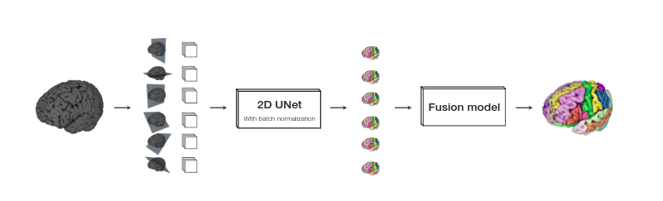
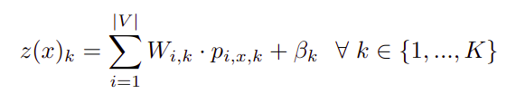
A Multi-View Fully Convolutional Neural
Network for Segmentation of Medical Image
Volumes

Slide 7
nnU-Net: Breaking the Spell on Successful Medical Image Segmentation
https://arxiv.org/pdf/1904.08128.pdf
nnU-Net (‘No new Net’) a framework that automatically adapts itself to any given new dataset
Basic idea is to configure Hyperparameters based on given dataset.
Consists of 3 U-Net (2-D, 3-D and 3-D cascade U-Net).
Best dice score achieved for the problem statement.

Slide 8
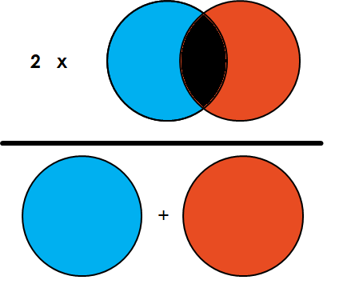
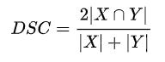
Evaluation Metric
Dice Score

Slide 9
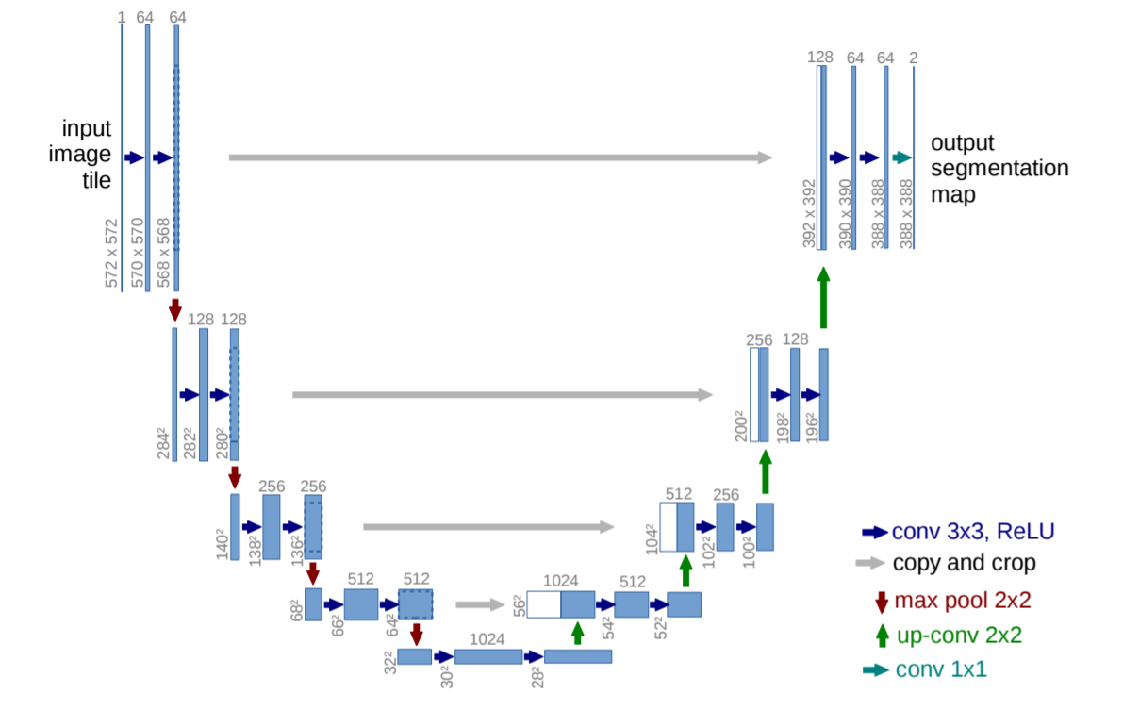
Unet Model
Unet model is a combination of encoder and decoder neural network especially used for image segmentation
VGG Unet model is used

Slide 10
Initial Goal
Achieve good score for individual organs and then generalize
Using 2 label organs only initially
Other organs also made 2 label : ROI and background

Slide 11
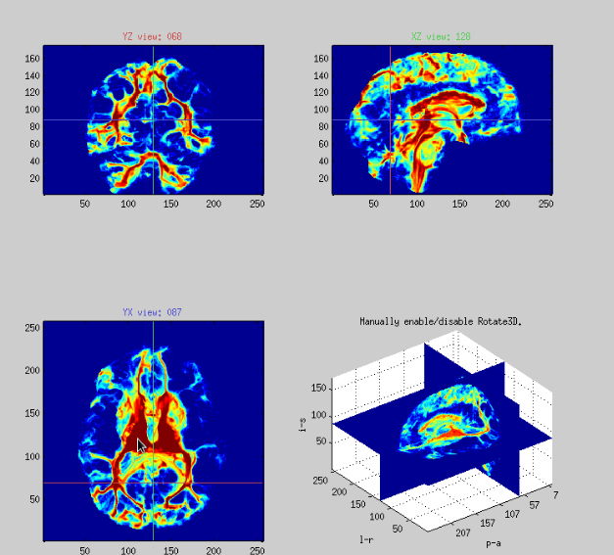
Preprocessing
2D slices of the 3D image along the 3 axis (X,Y,Z)
Resizing images to (224,224,3) for input to VGG
Normalizing images to [0,1] as some of the values are even greater than 1000
(- dice coeff) is used as the loss function

Slide 12
Stage 1 Problems
Using the individual slices for testing gives very high scores (heart 0.997, colon 0.998)
But giving score of 1 if no ROI is not correct
The number of slices with no ROI is very large making the overall average high

Slide 13
Stage 2
Model Learning to predict all 0 for organs such as Lung
So predict using the 3D image as a whole
Scores decrease drastically with this for lung, colon etc.
Balancing positive and negative slices 50:50
Scores improved a little with this modification

Slide 14
Stage 2 Results
Lung : 0.156 +- 0.246
Spleen : 0.74 +- 0.09
Heart : 0.69 +- 0.035
Hippocampus : 0.720 +- 0.104
Prostate : 0.7149 +- 0.0766
Colon : 0.02 +- 0.01
Pancreas : 0.381 +- 0.139
Hepatic Vessels : 0.171 +- 0.126

Slide 15
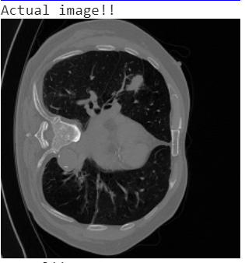
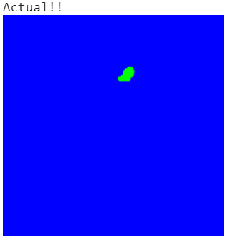
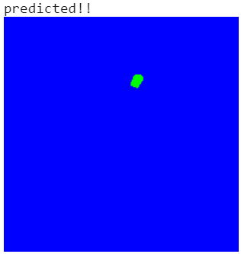
Result of Lung dataset
Some images of lungs with high dice score

Slide 16
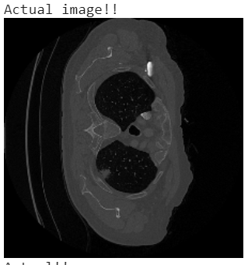
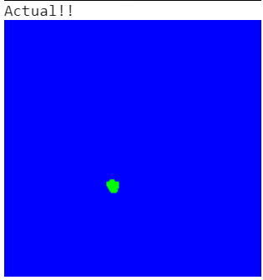
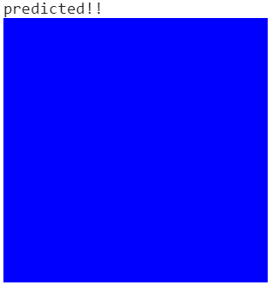
Result of Lung dataset
Some images of lungs with low dice score

Slide 17
Sample Images

Slide 18
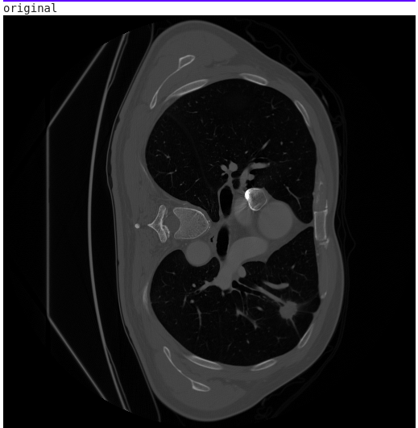
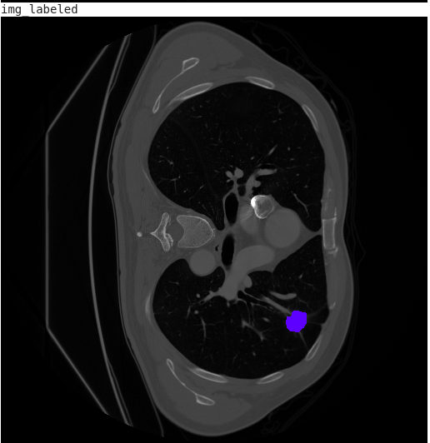
Images of Lungs

Slide 19
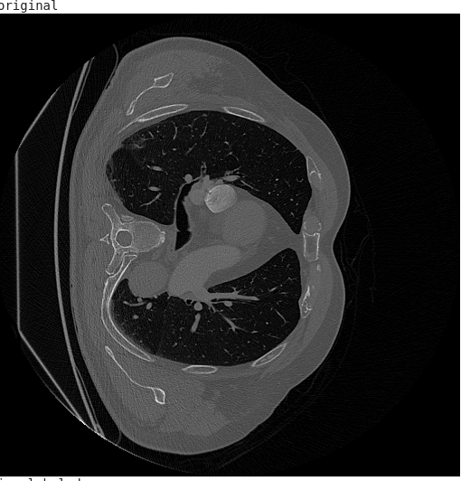
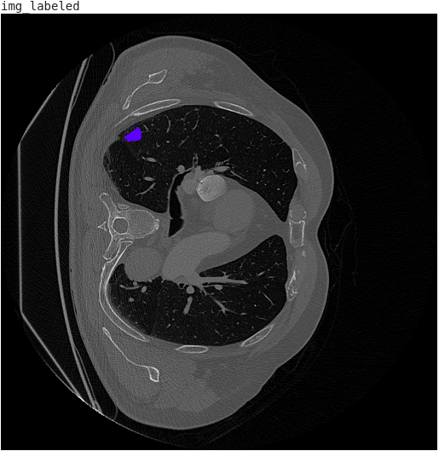
Images of Lungs

Slide 20
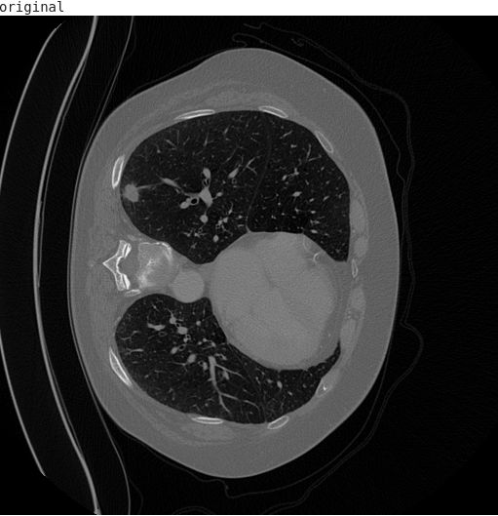
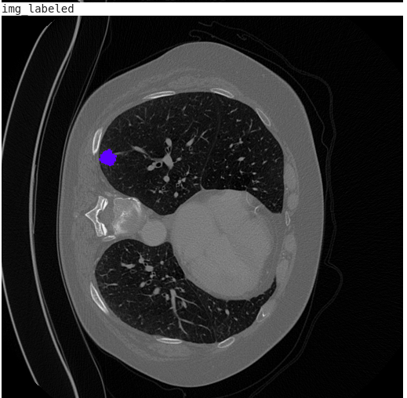
Images of Lungs

Slide 21
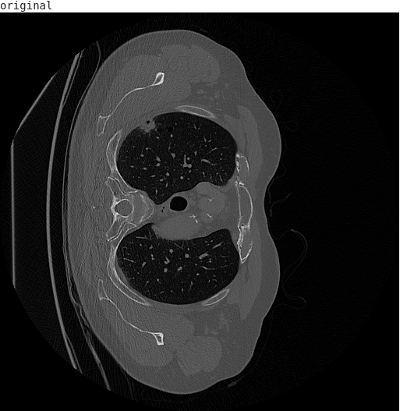
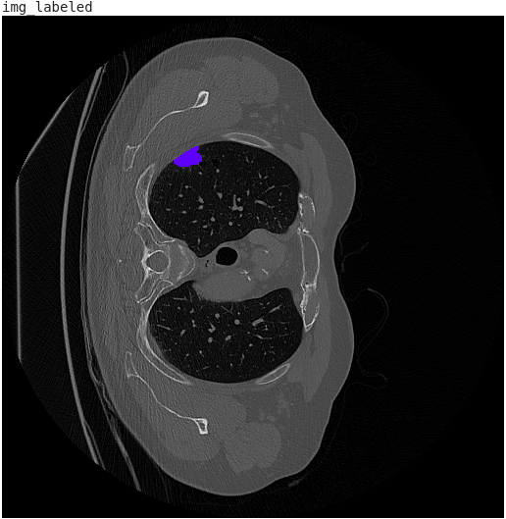
Images of Lungs

Slide 22
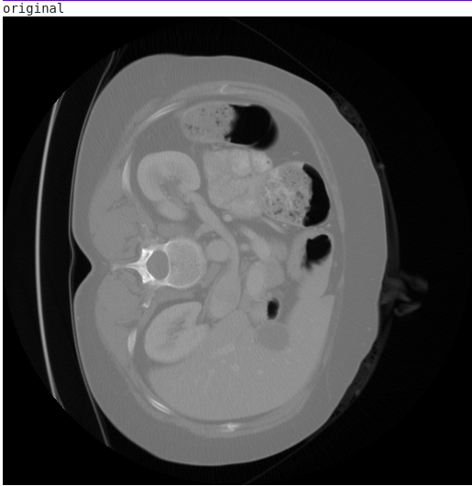
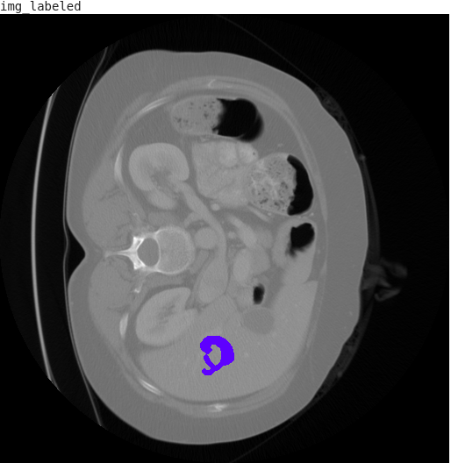
Images of Colon

Slide 23
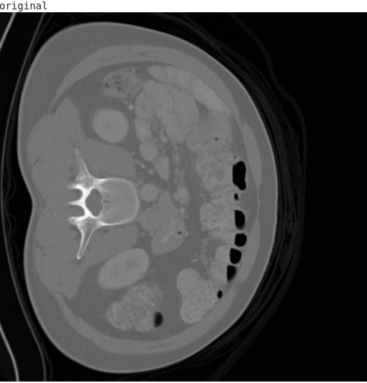
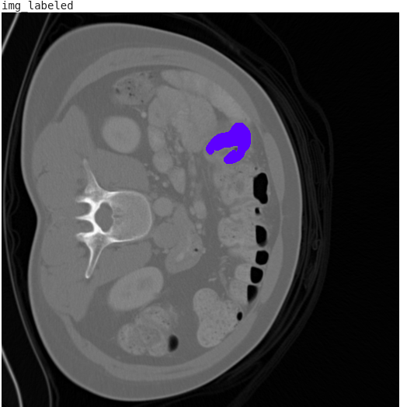
Images of Colon

Slide 24
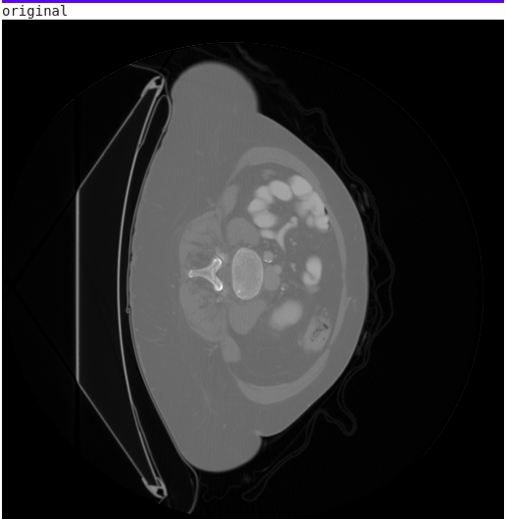
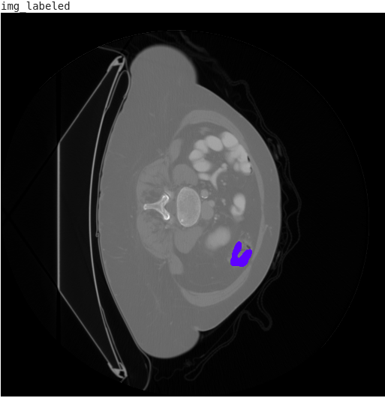
Images of Colon

Slide 25
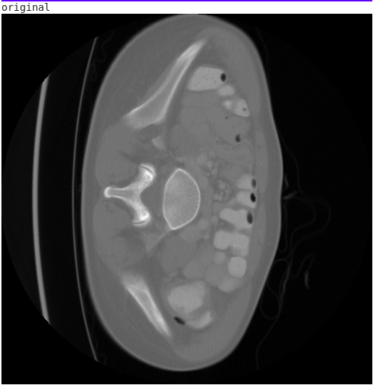
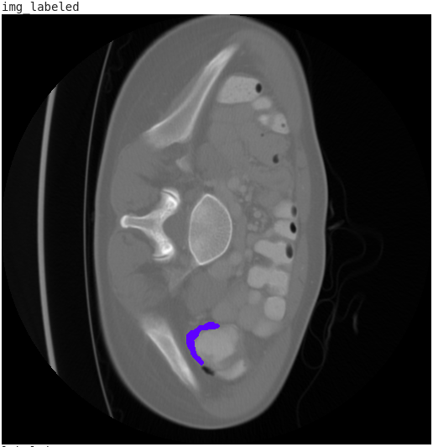
Images of Colon

Slide 26
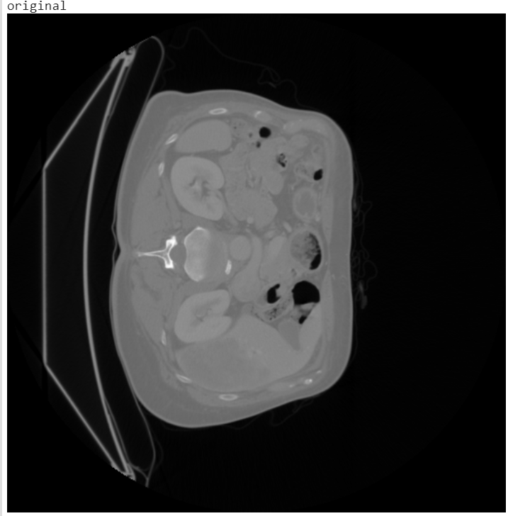
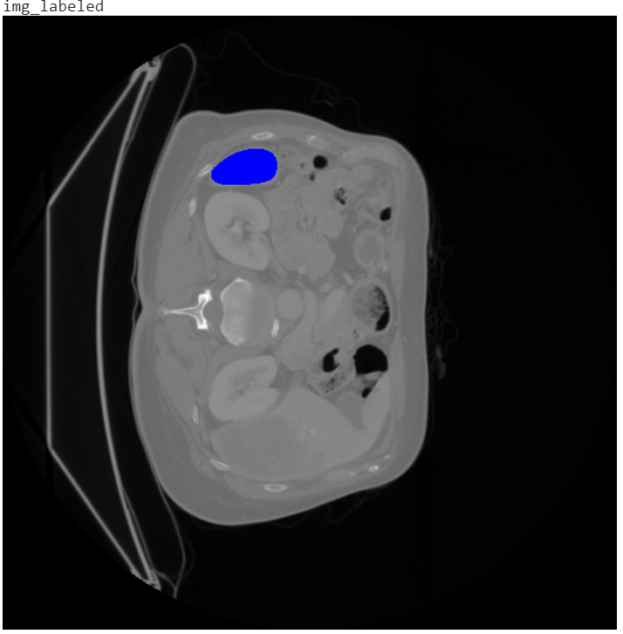
Images of Spleen

Slide 27
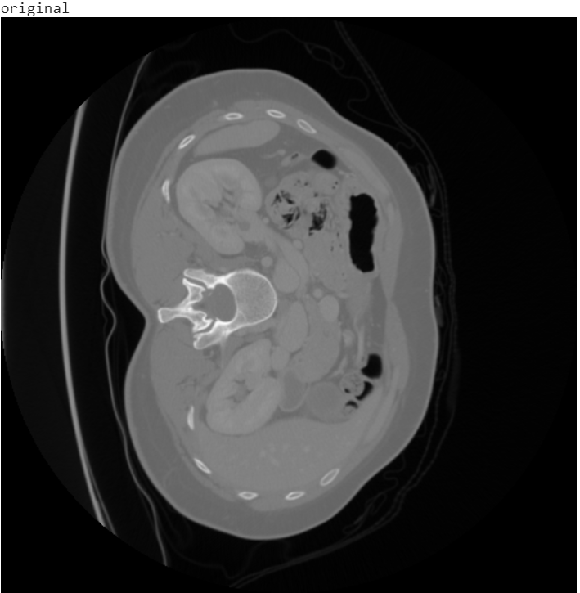
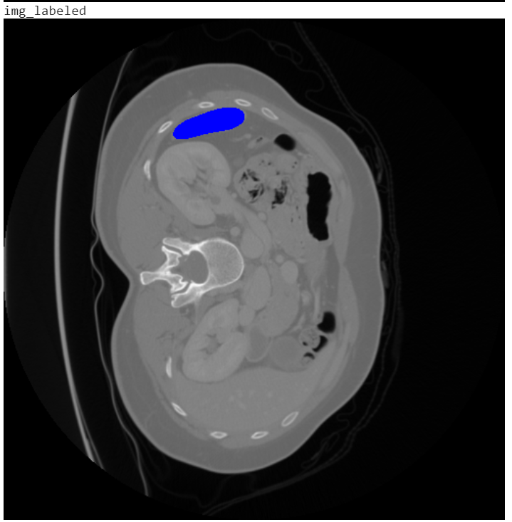
Images of Spleen

Slide 28
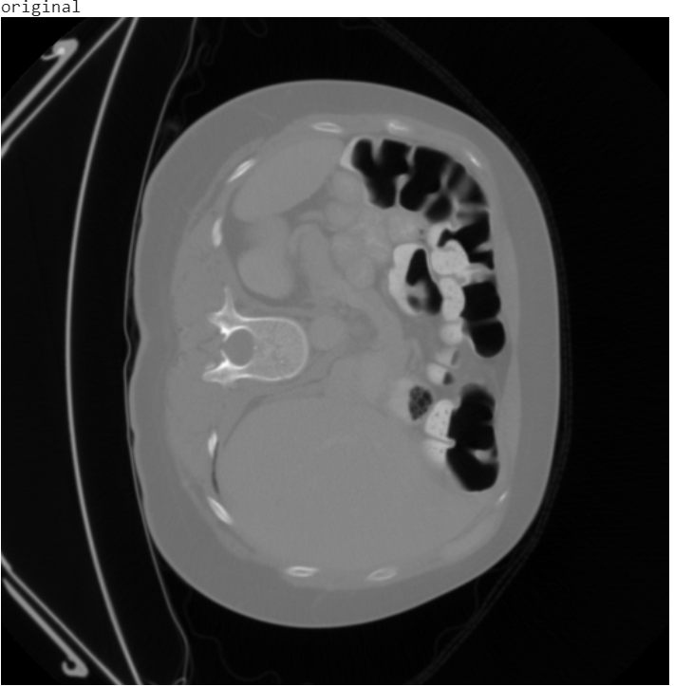
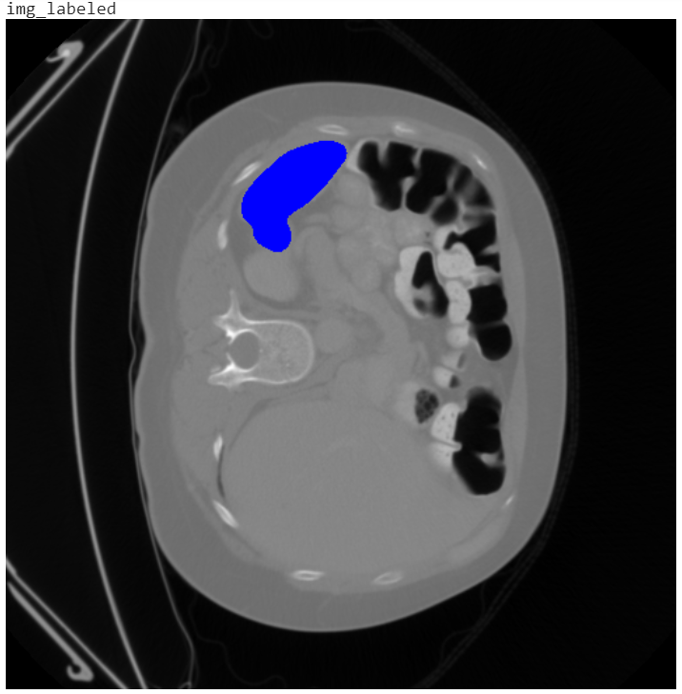
Images of Spleen

Slide 29
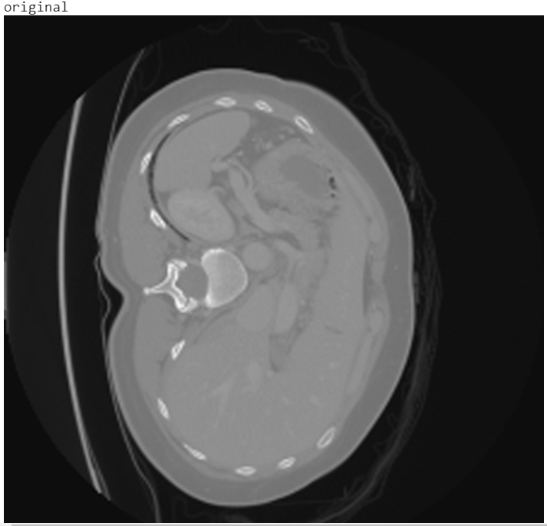
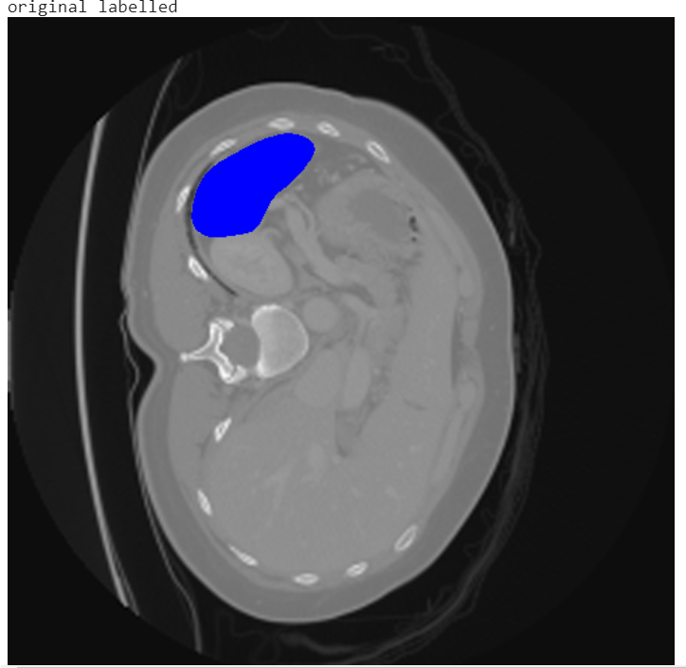
Images of Spleen

Slide 30
Stage 3
3 channels available as input to VGG
Contrast variation handling
Log and power transformation as the other 2 channels
Not that effective

Slide 31
Stage 4
3 channels available as input to VGG
Spatial Information Passing
Previous and next layer in the other 2 channels
Improved Results

Slide 32
Stage 4 Results
Lung : 0.2057 +- 0.211
Colon : 0.0642 +- 0.151
Pancreas : 0.341 +- 0.1

Slide 33
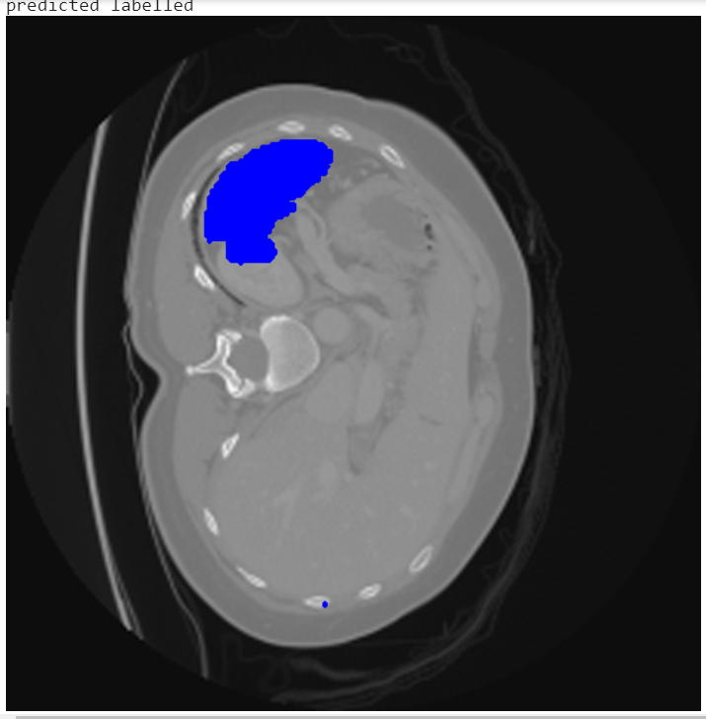
Result of Spleen

Slide 34
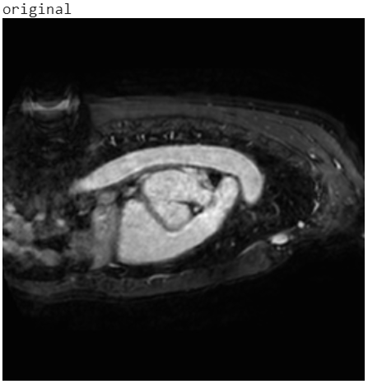
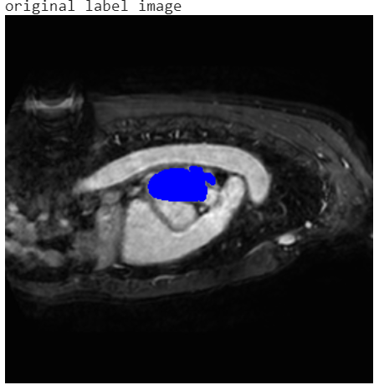
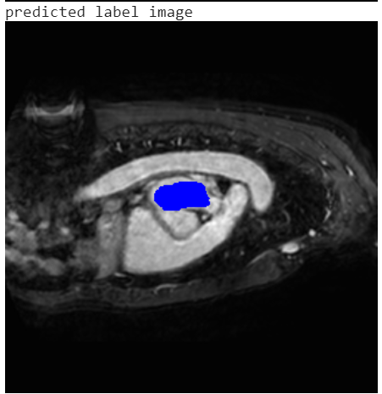
Result of Heart

Slide 35
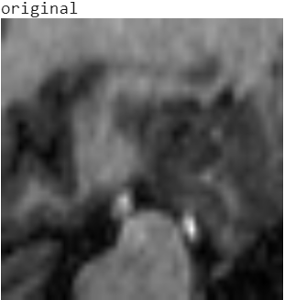
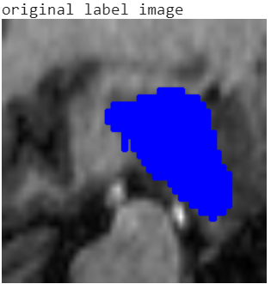
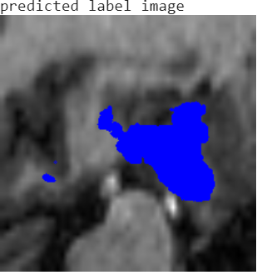
Result of Hippocampus

Slide 36
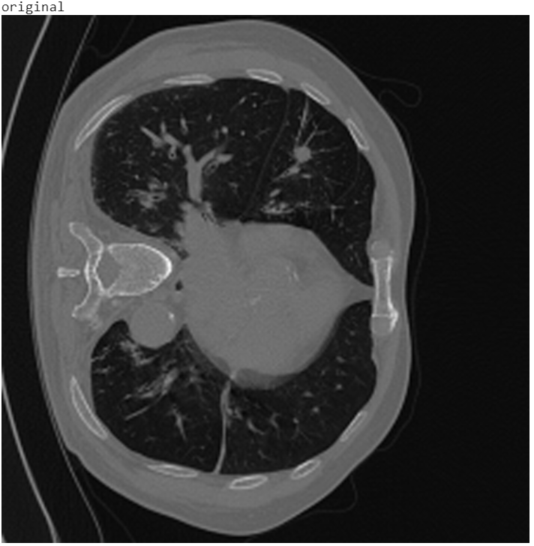
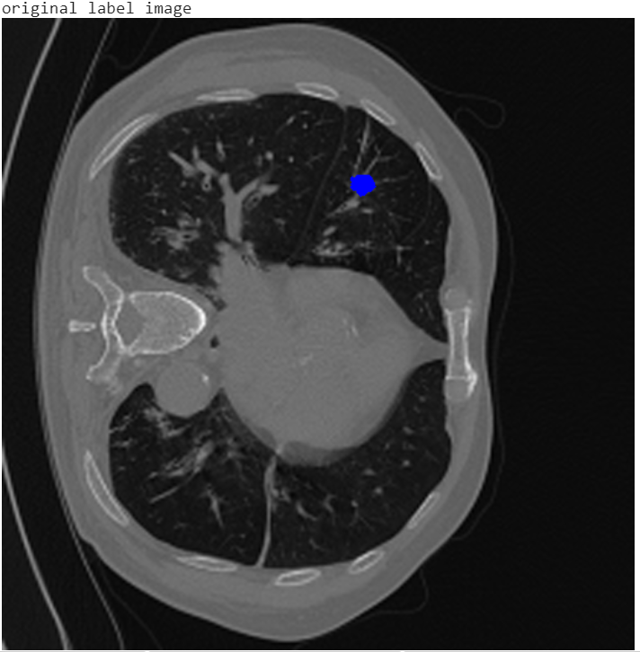
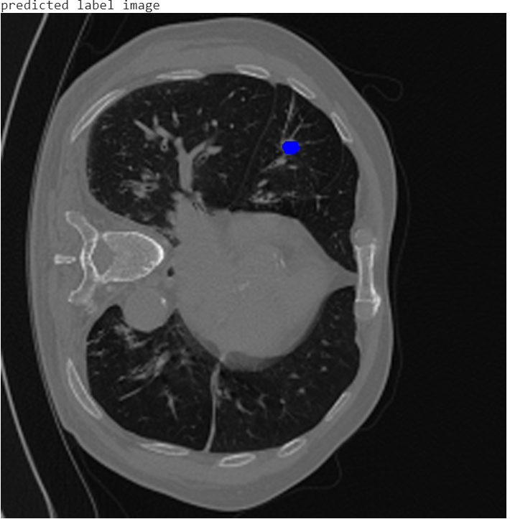
Result of Lung

Slide 37
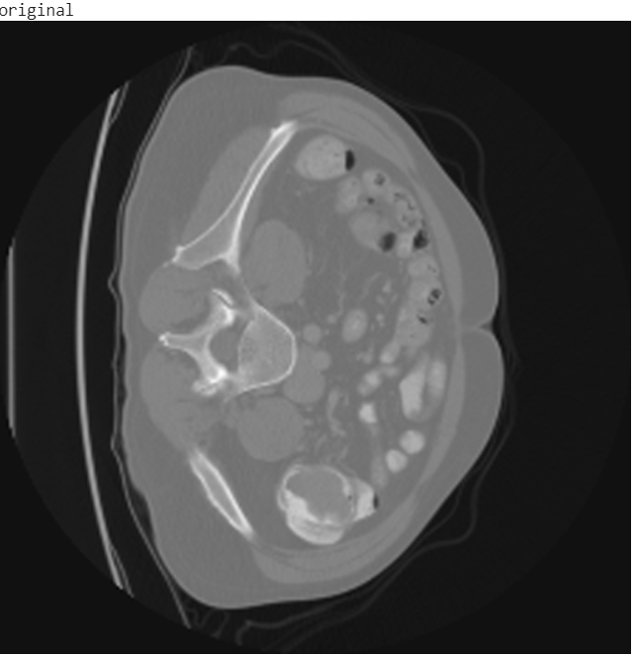
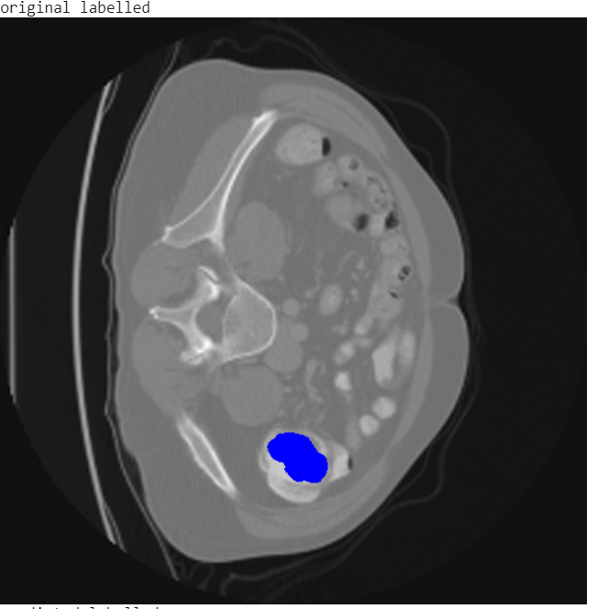
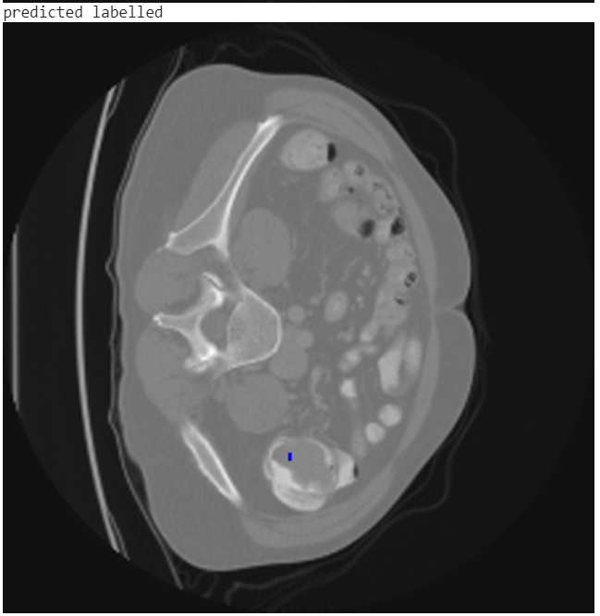
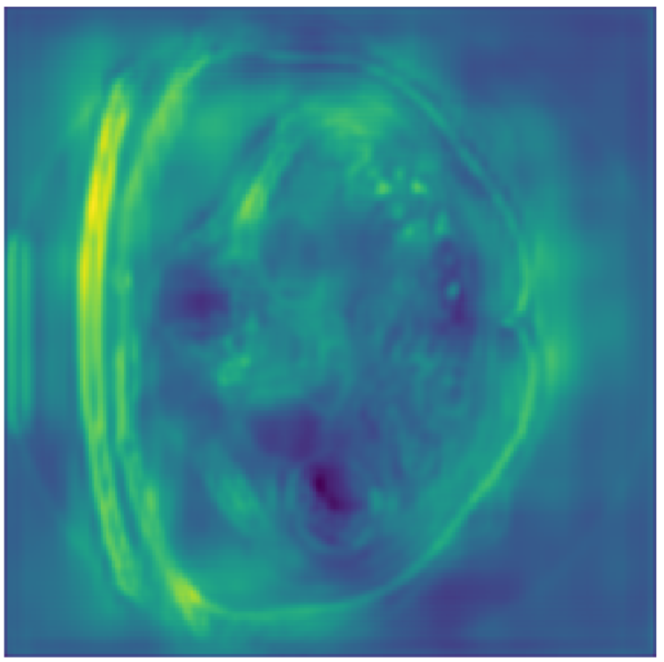
Result of Colon dataset
Not covering whole ROI

Slide 38




Result of Colon dataset
ROI predicted wrong

Slide 39
Modality based normalisation
CT scan consists of absolute values.
Normalisation is done across the dataset (Z-score) after clipping to the [0.5, 99.5] percentiles of these intensity values.
For other modalities, simple Z-score normalisation is applied across the individual images.

Slide 40
Scaled Model
Input dimensions of the vgg-unet model depends on the dataset used.
Example : Hippocampus Tried with (64,64) as the input dimension.
Non Uniform Input dimensions can also be used instead of (224,224) in case of rectangular images.
Hippocampus Result improved (from 0.720 +- 0.104 to 0.7608+-0.0455)

Slide 41
Training Procedure
Instead of giving slices along all the axes, Here we consider slices along the major axis
Model probably getting confused due to excessive variation in image sizes and anatomical information from different axis
Major axis slices giving better results even with lesser data compared to previous model

Slide 42



Images along different axes (Spleen)
Axis = 0
Axis = 1
Axis = 2

Slide 43
Results of previous change
Spleen : 0.85 +- 0.04
Pancreas : 0.5 +- 0.19

Slide 44
Ensemble model (along 3 axes)
The previous model solved the problem of variable data but ignores information available from other axis
Idea is to create a fusion model from the individual models trained along each axis
Currently simple OR operation used for this fusion
Because lesser region being predicted earlier
Connected Component Post Processing applied afterwards

Slide 45
Ensemble model (along 3 axes) : Result
Major improvement for spleen and Hippocampus
Spleen : 0.90 +- 0.01
Hippocampus : 0.77 +- 0.02
Pancreas : 0.42 +- 0.14
Pancreas showing a decreased dice score

Slide 46




Ensemble model (along 3 axes) : Results

Slide 47
Voxel Spacing
Voxel : 3D Pixel
CNNs do not natively understand voxel spacings.
Resample all the images of the dataset to have uniform voxel spacing
Resampled images to median voxel spacing of the dataset where spline interpolation is used for images.
Tested for lungs, No major improvement

Slide 48
Self-Supervised Learning
Inspired from Transfer Learning
Training model weights for some other task with large dataset and then using those weights for current problem with limited dataset
Limited low-level features learnt for the poor performing organs (eg. lungs)
Encoder contains the semantic information for the segmentation task
Features learnt through segmentation task could be less important when compared to other complex tasks such as image reconstruction.

Slide 49


Self-Supervised Learning
Image Reconstruction model sample results (Spleen)
Input image
Output image

Slide 50


Cropping images
Uniform and Non Uniform cropping across the dataset

Slide 51



Cropping Images (Result)
Non Uniform Cropping Spleen Result : 0.79 +- 0.11
Uniform Cropping Spleen Result : 0.88 +- 0.04 (improved from not cropping)
Actual Image
Actual label
Predicted label

Slide 52
Attention Gated Network
ROI varies greatly in shape and size
Attention helps in localisation of predicted region
Less false positives with almost no major complexity to training time.
Identify salient image regions and preserve only the activations relevant to the specific task
Each feature vector is scaled by the corresponding attention coefficient

Slide 53


Attention Gated Network

Slide 54

Attention Gated Network

Slide 55
Attention Gated Network Results
Lungs : 0.28 +- 0.28(improvement)
Spleen : 0.86 +- 0.01(almost same)
Pancreas : 0.52 +- 0.18(improvement)
Hippocampus : 0.71916 +- 0.0504
Heart : 0.7567 +- 0.0463 (improvement)

Slide 56
Ensemble Attention Gated Network
Trained 3 models corresponding to 3 different axes.
Ensemble using OR operation
Results:
Heart : 0.7677 +- 0.0358
Hippocampus : 0.7555 +- 0.059
Spleen : 0.79 +- 0.1

Slide 57
References
nnU-Net: Self-adapting Framework for U-Net-Based Medical Image Segmentation
A Multi-View Fully Convolutional Neural Network for Segmentation of Medical Image Volumes
Attention Gated Networks: Learning to Leverage Salient Regions in Medical Images

Slide 58

Thank you!

